Slide 1
The Labor Market and Public Policy Implications of Arts Entrepreneurship
Christos A. Makridis
Columbia Business School, Stanford University, and Living Opera
Jonathan Kuuskoski
University of Michigan School of Music, Theatre & Dance

Slide 2
Motivation
he U.S. Department of Education found that after financial aid is subtracted, 7 out of 10 of the most expensive schools are art institutions (9 out of 10 as of 2015!).
The Strategic National Arts Alumni Project (SNAAP) found that 66 percent of recent art school graduates are carrying substantial debt.
According to some survey results, 75% of artists say they need entrepreneurial and business schools, but only 25% say they received the training while in school.

Slide 3
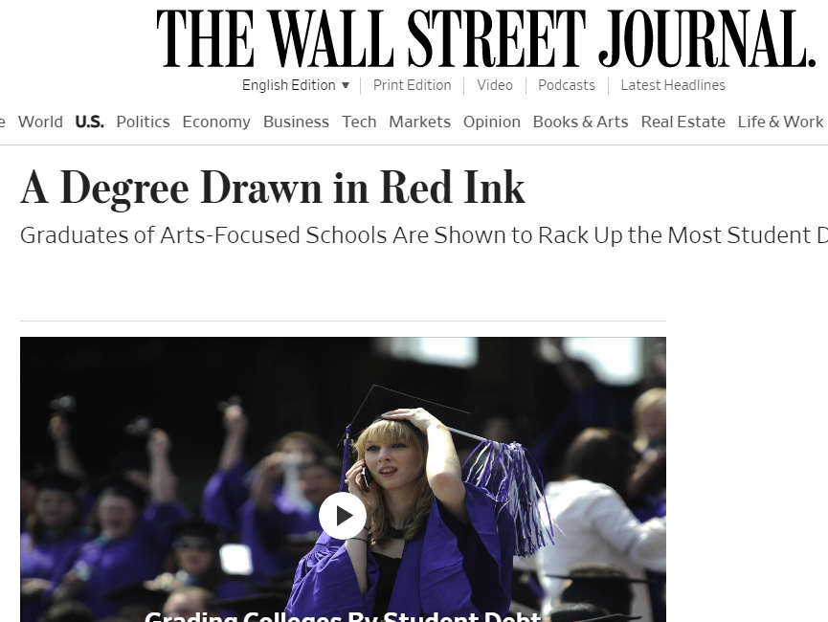

Slide 4
Today’s Goals
How have artists fared in the labor market, and what entrepreneurship programs exist for training artists to go out into the marketplace?
How can we help artists through the expansion of non-degree credentials?

Slide 5
Artists in the Labor Market
Using data on over 5.5 million individuals between 2009 and 2019 from the American Community Survey (Census Bureau), we find several major results.
Those with bachelors of arts in fine arts are 1.4 percentage points less likely to be employed, relative to their other bachelor counterparts.
They have 19.5% lower hourly wages.
If they are working in an arts occupation, they still earn roughly 1% less, but it is those who have a fine arts degree and work in a non-arts occupation that are especially suffering from a low wage job.
Those with a business administration double major do not have a difference in employment probability, but earn 3.3% more than non-business arts counterparts.
These results are controlling for age, race, sex, and occupational differences.
They suggest that the problem is concentrated among those who study the arts, but cannot get jobs, and those who do get jobs, but are outside their core field.

Slide 6
Arts Entrepreneurship Certificates/Training
We gathered data on the top 185 colleges and 37 music conservatories by hand.
Only 5% of colleges have an arts entrepreneurship certificate, and 11% have any requirements on courses related to arts entrepreneurship.
18% of the music conservatories have an arts entrepreneurship certificate, but 46% have some required courses on it.
While music conservatories “do better” in offering entrepreneurship training, they are much smaller, retain fewer scholarship options, and provide fewer resources for a full well-rounded education. These patterns highlight the need for greater integration between practitioners and higher education in the arts.

Slide 7
Solutions
In Living Opera, we’ve launched a non-degree credential called Beyond Your Big Break where we summarize lessons learned from Soula Parassidis and Norman Reinhardt:
How to manage an agent
Financial literacy
Branding and social media
Evaluating contracts
… and more
We are building a formal three-part certificate program that includes assessment and virtual interaction to ensure that “graduates” have absorbed the content.
Ultimately, we need more bridges between practitioners and colleges so that those with the actual knowledge and experience about how the arts works in the real-world can work with pedagogues who know more of the theory and have a platform to instruct learners within the confines of a university or conservatory.

Slide 8
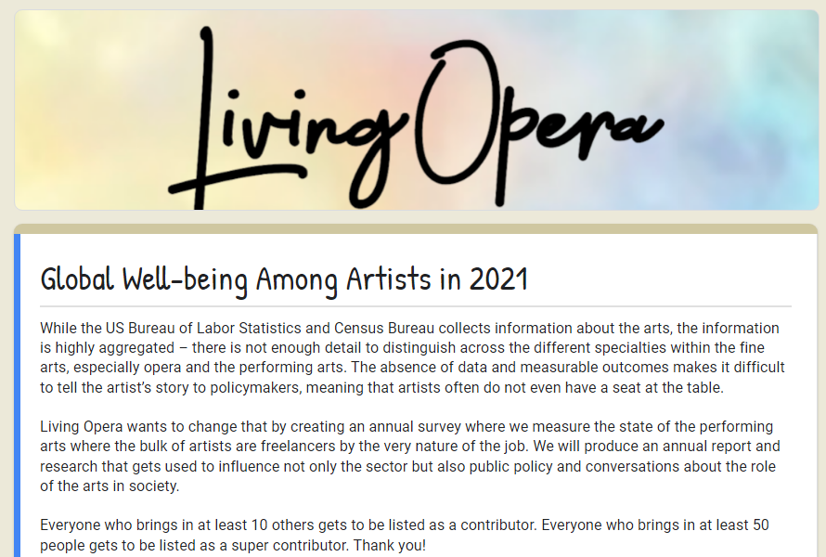
Supplementary Survey Evidence
The challenge with existing survey data is that it’s hard to study the mechanisms behind the phenomena – and impossible to drill down to specific areas of the arts.
Living Opera launched the Global Well-being Among Artists in 2021 survey.

