Slide 1
FEATuring YOU
A Badging Initiative for Opportunity Youth
Presented to the Non-degree Credentials Research Network January 27, 2020 Martin Kurzweil

Slide 2
What is FEATuring YOU?
Future Employment Assessment Tool
Digital assessment and learning program by Southern New Hampshire University (SNHU) Innovation Center
Project leads: Brian Fleming, Faby Gagne, Cat Flynn
Aims to connect “opportunity youth” to employment and education opportunities
Focused on 6 “soft” employment skills: communication, critical thinking, customer service, adaptability, drive for results, and problem solving
5 validated self-assessments and 1 gamified assessment that lead to SNHU digital badges, plus related learning opportunities
Funding from Google.org
Hosted on LRNG platform

Slide 3
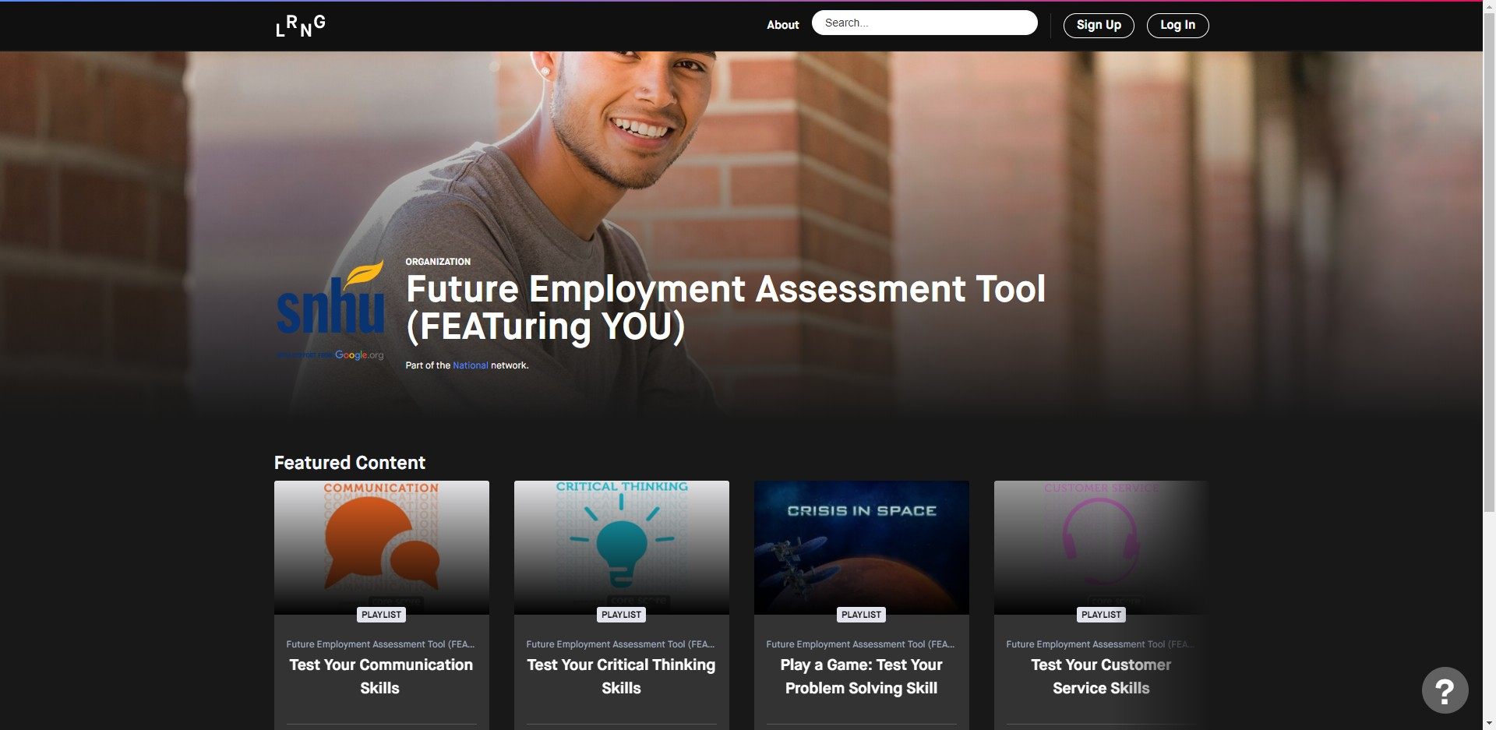
https://www.lrng.org/o/future-employment-assessment-tool-featuring-you

Slide 4
Why Study FEATuring YOU?
Interesting combination of:
Provider: non-profit mega-university with experience in competency-based, digital education and credentialing
Features: soft-skills assessments leading to digital badges
Credential earners: individuals between the ages of 16 and 24 who are unemployed, underemployed, not enrolled in school, or enrolled but not progressing academically
Potential for scale
Gauge reaction of employers to university-created badges
Gauge reaction of opportunity youth and their supporters to these alternative credentials
Get under the hood of the credential and assessment development process, identify key challenges and strategies

Slide 5
Research Scope
Amazing Research Team: Meagan Wilson, Julia Karon, Rayane Alamuddin
Subcontract with SNHU under Google.org grant
Goal: document the development and implementation of the program, understand its value-added and potential for impact in the field, and make recommendations for future developments
Methodology:
21 interviews (to date)
Document review
Test use of platform and assessments
Observe outreach events

Slide 6
FEATuring YOU Timeline
Milestone 1: Planning and Initial Development
Milestone 2: User Testing and Further Development
Milestone 3:
Platform Launch
Milestone 4: Increasing Platform Use & Data Collection
Advertising Campaigns for FEATuring YOU
Phase 1 (User Experience) Recruitment & Testing
Phase 2 (Feasibility)
Recruitment & Testing
FEATuring YOU Case Study by Ithaka S+R
Longitudinal Study for FY Participants (18+)
2017
Jan. 2018
Mar. 2018
Aug. 2018
Sep. 2018
Jan. 2019
Feb. 2019
Apr. 2019
Aug. 2019
Oct. 2019
Jan. 2020
Feb. 2020
Project proposed
Partnered with LRNG, Storyline LLC contracted for analysis of target audience
DUET Pop Up Event
Roxbury Event
Google.org funding secured
Partnered with Innovate + Educate
Employer Webinar
Platform Launched
Chicago LRNG Event
“Boys & Girls Club” Event
Initial meeting with LRNG
DUET Event & Campus Recruitment
Public Launch Event with DUET
“Working in Austin” Event
Boston Public Schools Event
Entangled Solutions contracted for analysis of existing platforms
“Crisis In Space” added to LRNG platform
SNHU and LRNG merge

Slide 7
Planning and Initial Development
Milestone 1: Planning and Initial Development
Key proposal features:
“Authentic Assessment Platform” for opportunity youth
map competency-based assessments to in-demand soft skills
facilitate job placement for its users
deliver further learning opportunities free of charge
Work with community-based organizations for reaching this target user base
Digital badges would be “stackable” into other credentials
IP would remain in public domain
Preliminary research and planning included:
Labor market data from Emsi and Burning Glass
Market overview from Entangled Solutions (confirmed decision to partner with LRNG)
Design work with Storyline
2017
Jan. 2018
Mar. 2018
Aug. 2018
Project proposed
Partnered with LRNG, Storyline LLC contracted for analysis of target audience
Google.org funding secured
Initial meeting with LRNG
Entangled Solutions contracted for analysis of existing platforms

Slide 8
User Testing and Further Development
Milestone 2: User Testing and Further Development
Decisions about tools:
Focus development efforts on gamified assessment of problem-solving – adapt “Crisis in Space”
License rather than build validated self-assessments on other skills – Innovate + Educates Core Score Entry-Level Core Skills Assessment for retail
SNHU merges with LRNG, which will host, badge, and provide learning through “Level Up Playlists”
Outreach and user testing:
Recruited opportunity youth for virtual UX testing for development of Crisis in Space assessment
Live events to promote tool and conduct user and feasibility testing, hosted by SNHU and LRNG CBO partners
Informational webinar for 4 potential employer partners
Phase 1 (User Experience) Recruitment & Testing
Phase 2 (Feasibility)
Recruitment & Testing
Aug. 2018
Sep. 2018
Jan. 2019
Feb. 2019
DUET Pop Up Event
Partnered with Innovate + Educate
Employer Webinar
DUET Event & Campus Recruitment
“Working in Austin” Event
“Crisis In Space” added to LRNG platform
SNHU and LRNG merge

Slide 9
Platform Launch, Increasing Use, and Data Collection
Milestone 3:
Platform Launch
Milestone 4: Increasing Platform Use & Data Collection
Platform went live February 2019
Continued development of Crisis in Space based on user feedback
Promoting and disseminating the tool:
Multiple live opportunities to take the assessments and use the tool, mostly in Chicago and Boston
Distributed print materials
Social media advertising
Promotional video explaining badging as a concept
Evaluation:
Mosio SMS-delivered survey to 18+ y-o users on employment outcomes (longitudinal study)
Ithaka S+R descriptive study
Validation study of Crisis in Space
Advertising Campaigns for FEATuring YOU
Phase 2 (Feasibility)
Recruitment & Testing
FEATuring YOU Case Study by Ithaka S+R
Longitudinal Study for FY Participants (18+)
Feb. 2019
Apr. 2019
Aug. 2019
Oct. 2019
Jan. 2020
Feb. 2020
Roxbury Event
Platform Launched
Chicago LRNG Event
“Boys & Girls Club” Event
Public Launch Event with DUET
Boston Public Schools Event

Slide 10
Users, Study Progress, Proximate Next Steps
877 users have visited FEATuring YOU
62% completed an assessment and received a badge
The most frequently completed badge was in Communication
15% engaged with a Level Up Playlist
Study Progress
237 participants opted-in to longitudinal study, current response rate of 14 percent; will continue through July 2020
Crisis in Space validation study includes 150 users to date
Ithaka S+R descriptive data collection and write-up complete, moving on to analysis of tools and identification of challenges and opportunities
Proximate Next Steps for SNHU
Developing Level Up Playlist for Crisis in Space
Integrate FEATuring YOU badges into broader initiative stacking LRNG badges into SNHU credit
Re-think promotional strategy to engage opportunity youth
Cultivate employer partners to make use of badges in hiring

Slide 11
Analysis
Value of badges is not innate
Need to be stacked into credit to have value in education
Employers need to recognize to have value in hiring
Opportunity youth will see value if badges translate into these tangible benefits
Will badges based on self-assessments be valued differently from demonstration through gamified assessment?
Meeting opportunity youth where they are
Difficulty accessing the target audience precisely because they are disconnected – who are the right intermediaries? What are the right channels?
Key to include opportunity youth in the design process; even with initial input, lots of changes based on user testing
Will opportunity youth who complete the assessments and earn the badges know what to do with the credentials?
Employer engagement is critical
Interest from employers but no concrete commitment to attach value to the badges in hiring
Alignment to aspirations but not to processes
Concerns about validity and using something “experimental”
While employers rely on third-party credentials, assessment, and validation in other contexts, would an assessment co-developed with a particular employer work best for opportunity youth without other signals of fit?

Slide 12
We Value Your Input
What questions would you want to see answered about FEATuring YOU?
What extensions or improvements could be made to the tool?
How could the tool be deployed most effectively? What are some pitfalls to avoid?
With what other initiatives could FEATuring YOU be connected or from which SNHU could learn?
How can SNHU (or a third party) best assess the efficacy of FEATuring YOU?

Slide 13
Thank you
Martin Kurzweil Director, Educational Transformation Program e: martin.kurzweil@ithaka.org t: @martinkurzweil
13

