Slide 1
Toward a Race-Conscious Understanding of the Federal Workforce System: Flaws and Opportunities
Alex Camardelle, Ph.D.
January 18, 2022
jointcenter.org

Slide 2
Our Mission
The Joint Center for Political and Economic Studies, America’s Black think tank, provides compelling and actionable policy solutions to eradicate persistent and evolving barriers to the full freedom of Black people in America. We are the trusted forum for leading experts and scholars to participate in major public policy debates and promote ideas that advance Black communities. We use evidence-based research, analysis, convenings, and strategic communications to support Black communities and a network of allies.

Slide 3
Workforce Policy
The Joint Center’s workforce policy program centers Black workers in policy debates concerning the future of work, workforce development, and access to good jobs.
The workforce policy program is about
the future of Black workers.

Slide 4
Why this matters to me
Years of experience in workforce development professionally
Concerned about lack of attention to the needs of Black workers that confront racism in the labor market
Lack of interventions that disrupt systemic barriers to higher earnings and wealth creation
Personal experience with supporting my brother as a young man who sought help from “opportunity youth” programs

Slide 5
The Future of Black Workers
Education is not the great equalizer: no matter where Black folks fall on the education spectrum, income and wealth disparities persist (see Darrick Hamilton’s work)
All jobs should be good jobs: Yes, education and training has a premium on economic opportunity, but it does not mean that those with fewer credentials should labor in jobs that exploit – especially given the history of Black labor in the United States

Slide 6
The Future of Black Workers means
Unmitigated access to education and training opportunities that seamlessly lead to work opportunities that promote economic mobility and wealth creation for Black communities
Strong supportive services for Black workers in low wage jobs that enable agency for workers to pursue the education and training necessary to move up the ladder
All Black workers are employed in high quality jobs that offer livable wages, enable wealth creation, offer flexibilities

Slide 7
The Future of Black Workers Research & Policy Agenda
Workforce Development
Federal, state and local workforce development policy
Program accountability
Registered apprenticeships
Supportive services
Postsecondary access and completion
Job Quality
Quality jobs access
Racial discrimination in hiring and the workplace
Occupational segregation
Labor power
Worker wages and benefits
Automation and displacement

Slide 8
Examples of Current Work
Preparing Black workers for the future of work
Building off the Joint Center’s seminal report on the future of work in the Black Rural South, we are collaborating with the congressional Future of Work Caucus to advance solutions to support Black workers at greater risk of displacement due to automation in the Black Rural South.

Slide 9
Examples of Current Work
Influencing workforce investments in Build Back Better legislation
Working in coalition with national partners to prioritize Black workers in Biden’s Build Back Better recovery package, calling on $80 billion -$100 billion in new workforce investments

Slide 10
Examples of Current Work
Shaping the Workforce Innovation and Opportunity Act reauthorization priorities
The Joint Center recently published recommendations for the reauthorization of the country’s landmark workforce development law, WIOA. So far, the recommendations have received positive feedback from leaders at U.S. DOL and Ed & Labor committee staff.

Slide 11
The Program’s Foundations
Challenging Flaws in Federal Workforce Policy

Slide 12
Background Workforce Innovation and Opportunity Act (WIOA)
Comprehensive Employment & Training Act
Reauthorizes Job Corps and the Summer Program for Economically Disadvantaged Youth (SPEDY)
Job Training Partnership Act
Repeals CETA, shifts primary responsibility for training youth to states and localities
Workforce Innovation Act
Replaces JTPA and includes titles for job training, adult education & literacy, employment services, and vocational rehab
1977
1994
2014 to Now...
1973
1982
1998
Youth Employment & Demonstrations Project Act
Increased funding for Job Corps and SPEDY; authorizes Youth Employment & Training Programs (YETP), Youth Community Conservation and Improvement Projects (YCCIP), & Youth Incentive Entitlement Pilot Projects (YIEPP)
School to Work Opportunity Act
Authorized grants to schools to develop ‘school to work’ systems
Workforce Innovation & Opportunity Act
Creates formula grant program to support Youth Workforce Investment Activities under Title I, Job Corps, and Youthbuild

Slide 13
Background Workforce Innovation and Opportunity Act (WIOA)
Three goals of WIOA:
Increase access to education, training, and employment – particularly for people with barriers to employment.
Reduce welfare dependency, increase economic self-sufficiency, meet employer needs, and enhance the productivity and competitiveness of the nation
Increase the prosperity of workers and employers

Slide 14
Background Workforce Innovation and Opportunity Act (WIOA)
WIOA-funded training programs can be divided into four categories:
Skill development programs, which increase vocational skills through classroom or on-the-job training
Job-development programs, which consist of public employment programs where jobs are specifically created for the participants;
Employability development programs, which, according to Butler and Hobbie (1976) emphasize personal attitudes and attributes needed for employment (i.e., what we would now call “soft skills”); and
Work experience programs, which provide employment experiences intended to help workers gain the same attitudes and attributes as employability development programs through paid or unpaid work.

Slide 15
Problem Statement
Rarely, if ever, is discourse analyses to understand the role that ideology, language, and power may play in the formation and implementation of the federal Workforce Innovation and Opportunity Act (WIOA).
“WIOA is a colorblind or race-neutral policy; that is, although its purpose is to provide opportunities to previously marginalized adults, it seeks to apply solutions without consideration for race or the existence of past or present racial discrimination”

Slide 16
Theoretical Foundation: Theories of Political Economy, Neoliberalism
Pauline Lipman (2013) defines neoliberalism as “an ensemble of economic and social policies, forms of governance, and discourses and ideologies that promote individual self-interest, unrestricted flows of capital, deep reductions in the cost of labor, and sharp retrenchment of the public sphere”
Neoliberals advocate for extending the doctrine of the free market to embrace every part of public and personal worlds and entails the transformation of states and governments from being providers of social welfare to promoters of markets and competition

Slide 17
Theoretical Foundation: Theories of Political Economy, Neoliberalism
Ahlberg et. al (2019) argue that the neoliberal silencing of racism results in a process that actually makes racism even more invisible because it “removes any suggestion of white supremacy or white guilt from personal thought and public discussion while legitimizing the existing social, political, and economic arrangements which privilege whites” (p. 3)
The beauty of color-blind ideology is that it aids in the maintenance of white supremacy without fanfare, without naming those who it subjects and those who it rewards...thus whites enunciate positions that safeguard their racial interests without sounding "racist." - Bonilla-Silva, in Racism Without Racists
Dana-Ain Davis (2007) asserts that color-blindness “willfully misconstrues and dismisses the reality of racism as a powerful explanatory factor in analyzing persistent racial inequities.” (p. 350).

Slide 18
Theoretical Foundation: Theories of Political Economy, Neoliberalism
Governmentality:
As Dumas argues, “governmentality refers not only to the technologies of policy implementation, but also, and equally important, the logics that frame policy proposals, policy discourse, and even policy evaluation and assessment.”
Governmentality: the collective logic used to generate knowledge about populations, institutions, and spaces, as well as problems and solutions
These logics operate to constitute, position, make productive, regulate, moralize and govern people in public policy

Slide 19
Theoretical Foundation: Theories of Political Economy, Neoliberalism
Race Neutrality
Lack of explicit language or terms that call attention to racism in the labor market is perpetuated by neoliberal ideologies that privilege personal responsibility/individualism as truth over systemic failures of the economy and public policy
Neoliberalism establishes a paradox where the poorest in society have to find solutions for their own education and social welfare with the extraordinary expectation that nothing will interfere with their individual effort to move out of poverty—not even racism

Slide 20
Examples of “common sense” in workforce policy: Personal Responsibility
The Common Sense Logic:
The unemployed fail to take advantage of opportunities for self-governance (and investment) ostensibly available to all, regardless of race”
Goal #2 of WIOA: ”Reduce welfare dependency” and it’s origins in the Personal Responsibility and Work Opportunity Reconciliation Act of 1996
Why this is flawed:
WIOA is based on the perceived failings of individuals (such as not investing significantly enough in one’s own human capital through education) rather than being attributed to any systemic property
The benefits of employment and hard work are not distributed equitably.
Nationwide, a household headed by a white person with a high school diploma holds about twice as much wealth as a household headed by a Black person with a four-year college degree

Slide 21
Examples of “common sense” in workforce policy: Economic Burden
The Common Sense Logic:
“We estimate that the total taxpayer burden for each under-attached Opportunity Youth is $215,580. The total social burden is $596,640 per youth.… Across the 3.3 million such youth, the total fiscal loss is $707 billion and the total social loss is $1.96 trillion.
“youth who are disconnected may pose a financial burden if they rely on cash and non-cash assistance programs, or if they become homeless”
Why this is flawed
It is ironic that businesses and policymakers express concerns about the taxpayer burden of the unemployed, yet they depend on tax cuts that prohibit redistributive policy solutions that could promote better educational, health, and financial opportunities that improve racial equity.

Slide 22
Examples of “common sense” in workforce policy: The Skills Gap
The Common Sense Logic:
The skills gap is understood as the primary culprit preventing America’s employers from finding talented workers and keeping Black workers from finding meaningful, living wage employment
Why this is flawed
The skills gap narrative is driven by employers in the low-wage job market, a market where Black workers are overrepresented
The skills gap discourse is used to justify the maintenance of poor labor conditions, particularly among Black workers
There is hypocrisy in expressing concern about the lack of skilled workers while employer-lobbyists/legislators simultaneously pass policies that keep taxes so low in states with larger shares of Black workers that public K-12 and higher education programs remain underfunded

Slide 23
Confronting the Flaws
Applying these foundations to the Joint Center’s policy recommendations

Slide 24
WIOA and Black workers
Black workers are disproportionately represented among those using WIOA services.
More than one in three (35 percent) workers who completed WIOA-funded services between April 2019 and March 2020 was Black, despite making up just 12.6 percent of the country's labor force.9

Slide 25
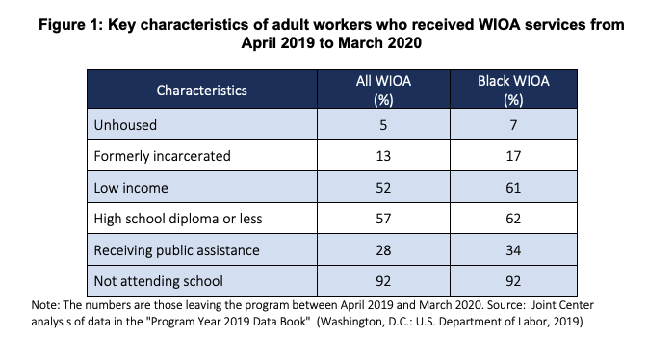

Slide 26
WIOA and Black workers
WIOA's individualistic and race-neutral orientation dismisses racism in the labor market and in the workplace, which weakens the ability of training providers to advance equity through workforce development.

Slide 27
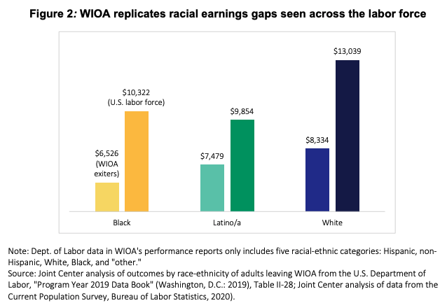

Slide 28
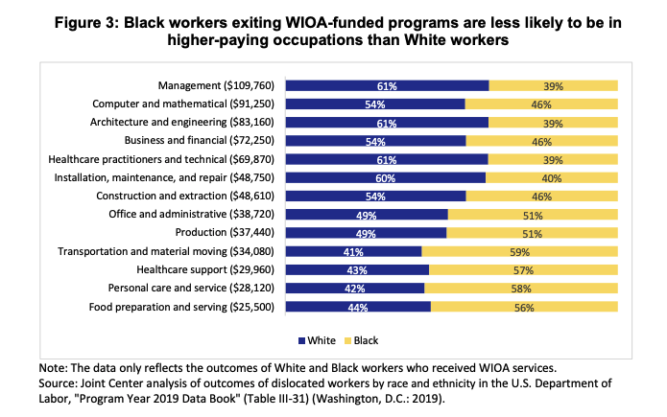

Slide 29
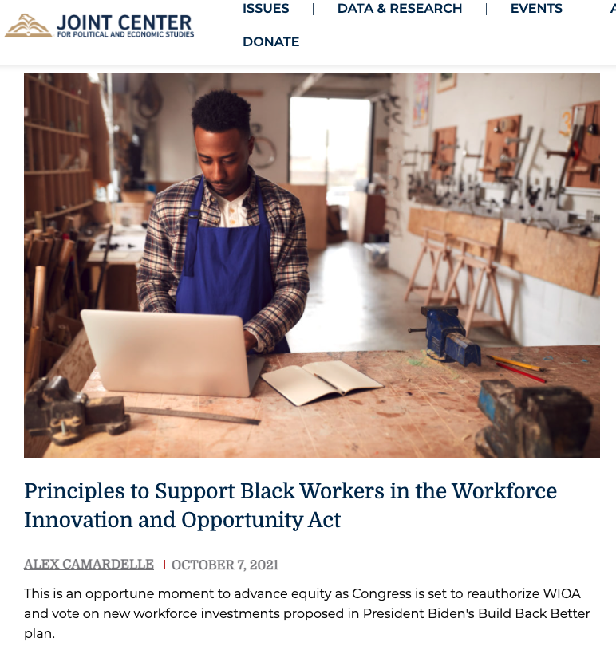
5 Principles
WIOA guardrails must be put in place to protect Black workers from occupational segregation.
WIOA must explicitly acknowledge discrimination in hiring and in the workplace.
WIOA must compensate Black workers shouldering the opportunity costs of training.
WIOA must invest in data systems that track program-level outcomes for Black workers.
Black job seekers must share power with workforce system decision-makers.

Slide 30
CONTACT US
alex@jointcenter.org
jointcenter.org

