Slide 2
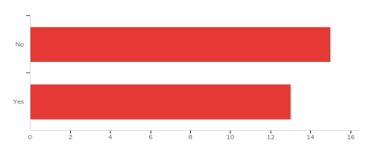
Figure 1: Whether universities have a specific micro-credentialing policy
Figure 1 shows 54% of institutions do not have a specific micro-credentialing policy, while 46% do
Out of those who do not have a specific micro-credentialing policy, 14 respondents say they will have some kind of formal reference to micro-credentialing or a policy within the next 12 months
This would mean almost all respondents will have a policy or similar in place next year

Slide 3
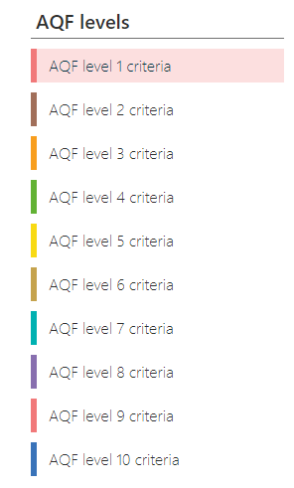
aqf.edu.au

Slide 4
dese.gov.au/higher-education-publications/resources/national-microcredentials-framework

Slide 5
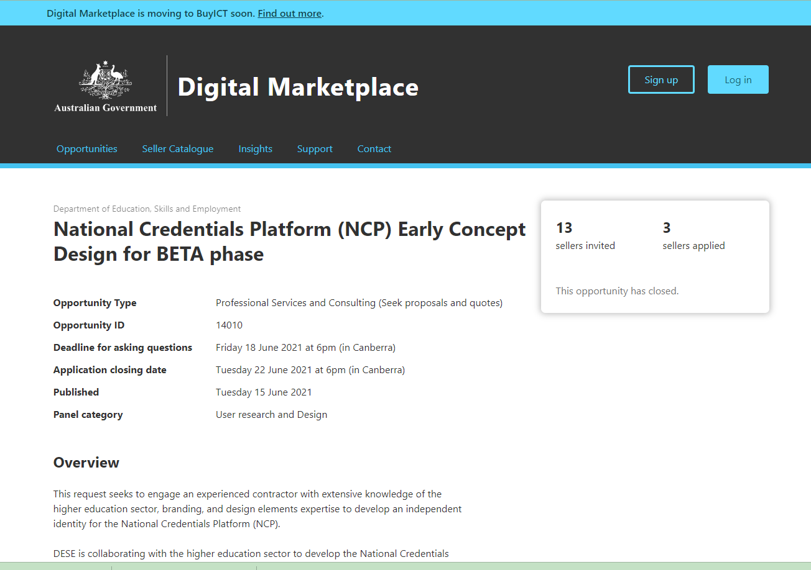

Slide 6
nationalskillscommission.gov.au

