Slide 1
Virginia Office of Education Economics (VOEE)
Beaver Dam Farm, Roanoke Region
March 2022

Slide 2
What we Do
In January 2021, SB1314 created the new office of education and labor market alignment at VEDP, with two complementary functions:
Provide a unified, consistent source of analysis for policy development and implementation related to talent development
Offer resources and expertise related to education and labor market alignment
We work closely with key partners to accomplish our mandate. VOEE’s key partners include the Virginia Dept of Labor, the Virginia Secretariat of Commerce & Trade, SCHEV, Higher education institutions, Virginia Dept of Education, Virginia Employment Commission, GO Virginia, Virginia Board of Workforce Development, and other workforce partners.
Virginia Tech

Slide 3
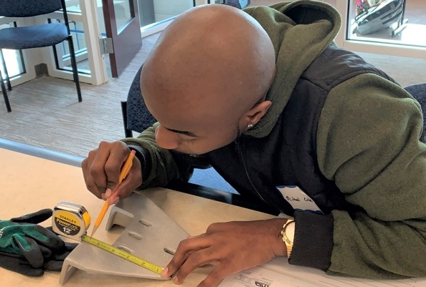
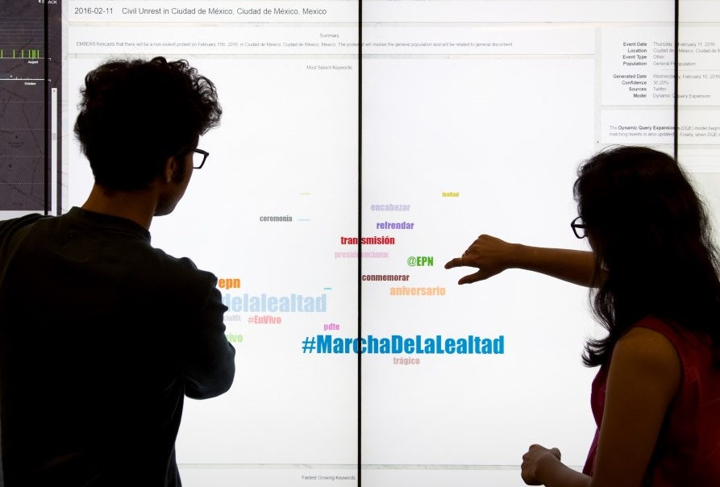
Non –Degree Credentials in Our work
VA State-Wide Supply-Demand Comprehensive Labor Market Data Analysis​
The majority of focus in the next year will be on creating this foundational data analysis.
Taking a look at existing non-degree credential data in Virginia
Workforce Credential Grant/Fast Forward – community colleges
Funding streams work – workforce and education
Differences in state data and institutional data
Bills in this session on non-degree credentials
Virginia Skills Initiative
Develop two new data sets for Virginia.
Tracking alumni to gather info on occupation, job alignment w/ major, migration etc.
Develop a supply side skills data set

Slide 4
Non-degree credential legislation
HB 1275: Virginia Credential Registry
Virginia Credential Registry; established. Directs the State Council of Higher Education for Virginia to create the Virginia Credential Registry for the purpose of ensuring that the general public has access to essential information about all educational and occupational credentials that are delivered, issued, funded, recognized, authorized, overseen, or governed in the Commonwealth. The bill describes such credentials as all degrees, certificates, certifications, licenses, apprenticeships, military training, diplomas, and badges that are available in the Commonwealth. The bill sets out other information required to be included in the Registry and requires the Council to establish and populate the Registry no later than July 1, 2023, and report on its progress in implementing the Virginia Credential Registry to the General Assembly no later than October 1, 2023.
Richmond Main Street Station

Slide 5
Non-degree credential legislation
HB 565: Advanced Manufacturing Talent Investment Program and Fund; created, report.
Advanced Manufacturing Talent Investment Program and Fund. Creates the Advanced Manufacturing Talent Investment Program and Fund to assist qualified institutions, as defined in the bill, in reaching, by 2042, a goal of increasing by at least 25,000 new eligible credentials, which are noncredit workforce credentials awarded by a qualified institution in a high demand advanced manufacturing field as identified by the Board of Workforce Development. To be eligible for an annual grant, a qualified institution is required to enter into a memorandum of understanding setting forth specific criteria for eligible credentials, eligible expenses, credential production goals, and completion rates.
Arlington County

Slide 6
VOEE Skills Initiative Will develop two new data sets for the Commonwealth to inform data driven decision making for stakeholders at all levels
Skills Database
Collect information on skills and competencies taught in Virginia higher ed and some secondary programs
Collect information on non-degree credentials awarded in education programs.
Will be directly included into the supply demand metrics
Can be used to inform:
Worker preparation or reskilling
Transference of skills for skills-based hiring
Student decision making/career navigation
Individual Learner records
Alumni Tracking – Database will be built by collecting social media information related to education and work for graduates of Virginia institutions
Help to understand first/second jobs out of school, occupations, migration, non-degree credentials students have acquired.
An addition to the recent survey of graduate
Can be used to inform:
Pathways work
Student and worker navigation
Migration
Occupation/wage/major alignment
Chesapeake Bay Bridge

Slide 7
Questions? Get in touch
Heather McKay Executive Director hmckay@vedp.org
Maggie L. Walker Governor’s School, Richmond

