Slide 1
Defining the Quality of Non-Degree Credentials
Michelle Van Noy
Education & Employment Research Center
Rutgers, The State University of New Jersey
Non-degree Credential Research Network Webinar
November 5, 2019

Slide 2
The Rise of Non-Degree Credentials
Rapidly changing labor market
Increased need for lifelong learning, just in time training
Proliferation of different types of NDCs

Slide 3
Many Adults Hold NDCs

Slide 4
Types and Definitions of Non-Degree Credentials
Type | Definition
Sub baccalaureate credit certificates | Credential awarded by an educational institution for completion of a subbaccalaureate credit educational program, usually less than one year in length (short-term and long-term credit)
Non-credit certificates | Credential awarded by an institution (educational or workplace) for completion of a noncredit educational program
Apprenticeship | Credential awarded after completion of structured educational and workplace program based on industry and occupational standards.
Industry certification | Credential awarded by an industry body or governmental agency for demonstration of skills typically via examination based on industry or occupational standards.
Occupational or professional licensure | Credential awarded by a governmental agency for demonstration of skills in a specific occupation and sometimes also completion of an educational program; often required to work in an occupation.
Badges, microcredentials | Credential awarded for completion of a short program of study or demonstration of a targeted set of skills; these are newly emerging and are still being developed.
Notes:
Awarded by a wide range of organizations
Colleges, industry groups, unions, government, etc.
Awarded based on a variety of criteria
Course completion, work experience, examination, etc.
Learning occurs in many locales
At school, at work, informally
Data is located in many sources
State data systems, industry data, national surveys

Slide 5
Credentials Quality Frameworks
Conception of quality is similar for traditional and non-degree credentials though with slightly different emphasis
Lumina Quality Credential Task Force framework provides most broad outlook
Rutgers EERC non-degree credential quality conceptual framework also seeks to provide broad framework

Slide 6
Uses of Conceptual Frameworks for Quality
Importance of examining equity
Quality elements as a guide
Quality elements as diagnostic tool
Quality relative to goals
Quality relative to context

Slide 7
Lumina Quality Credential Task Force framework
Outcomes for individuals and society
Intentional design
Student centered institutions, policies and practices
Unlocking the Nation’s Potential: A Model to Advance Quality and Equity in Education Beyond High School
https://www.luminafoundation.org/resources/unlocking-the-nations-potential

Slide 8
Conceptual Model of Credential Quality
Societal Outcomes
of Quality System
Individual Outcomes
of Earning Quality Credentials
Intentional Program Design
Student-Centered Policies & Practices
Quality Assurance System
Federal Policies | State Policies | Accreditation | Institutional Policies

Slide 9
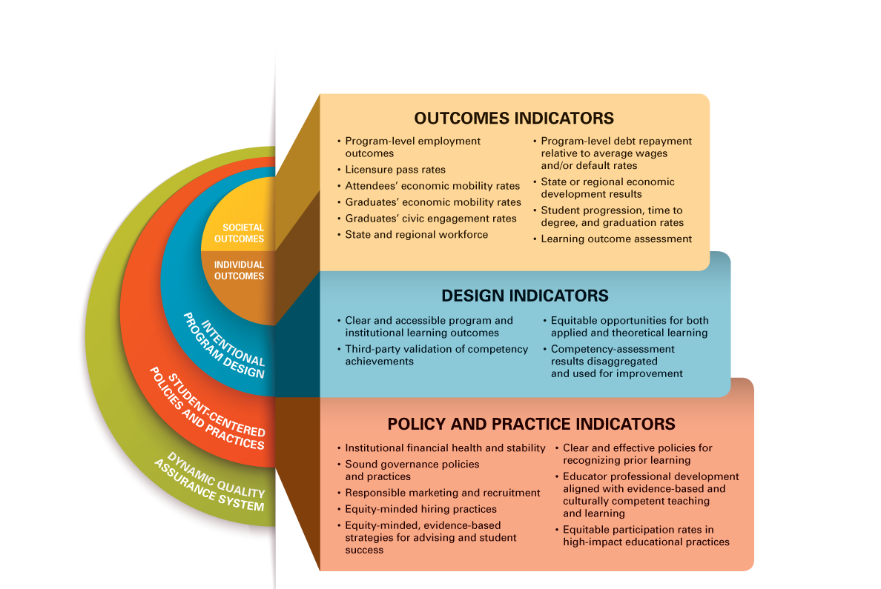
Key Indicators of New Quality Assurance System

Slide 10
Rutgers Non-Degree Credential Quality Framework
Credential design. Includes numerous features, usually decided on by the credential grantor, that define what a credential represents in terms of the competencies it marks and how it seeks to do so.
Competencies. Skills and knowledge possessed by the credential holder.
Market Processes. Ways credentials come to be recognized and have currency.
Outcomes. Educational, employment, and social advancement of individuals, employers, and society.
Non-Degree Credential Quality: A Conceptual Framework to Guide Measurement
https://smlr.rutgers.edu/NDCQuality

Slide 11
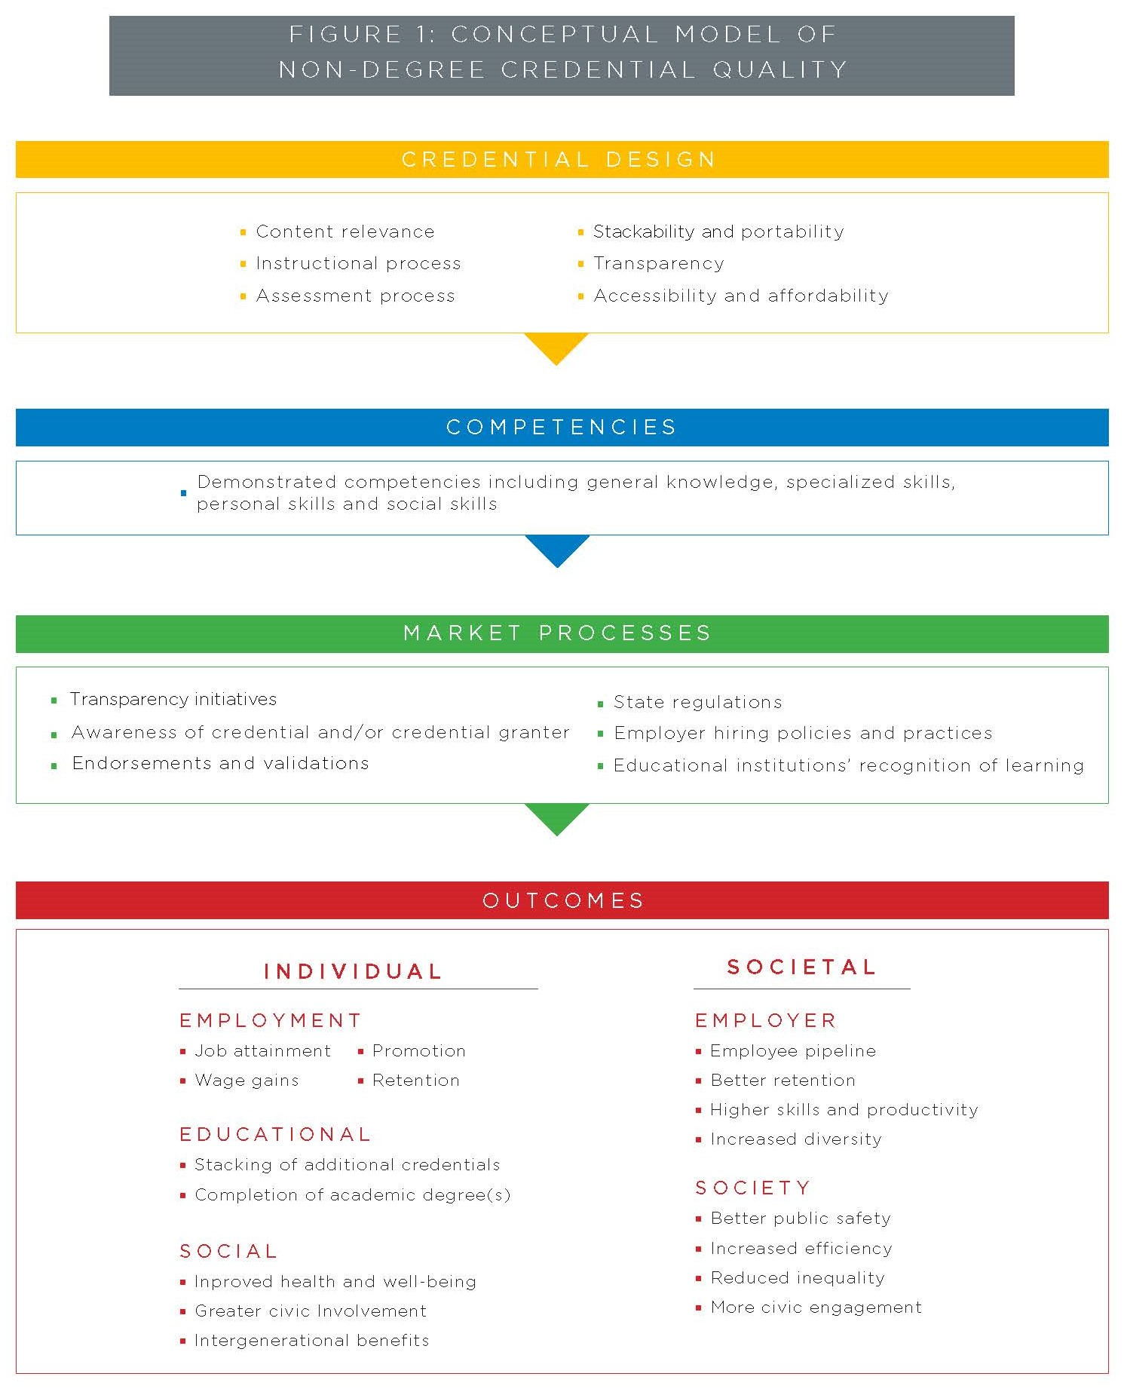
Conceptual Model of Non-Degree Credential Quality

Slide 12
Implications for Policy and Practice
Need to….
Create awareness of non-degree credential quality and how to measure it.
Collect better information on non-degree credential quality and outcomes.
Develop and promote systems to assess non-degree credential quality.
Promote and understand the use of data on non-degree credential quality.

Slide 13
Implementing Non-Degree Credential Quality Standards
Education Strategy Group’s toolkit offers a guide for implementation:
Identify high-value non-degree credentials
Validate the preliminary list of priority non-degree credentials
Incentivize attainment of priority non-degree credentials
Report on attainment of priority non-degree credentials
Building Credential Currency: Resources to Drive Attainment across K-12, Higher Education and Workforce Development http://edstrategy.org/resource/building-credential-currency/

Slide 14
For more information, get in touch:
Michelle Van Noy
mjvannoy@rutgers.edu
848-445-4734
Visit our website at: smlr.rutgers.edu/eerc
Education and Employment Research Center
School of Labor and Management Relations
Rutgers, the State University of New Jersey

